Slide 1
Production Quality Assurance
Anna Mörkerdal

Slide 2
Certification levels
ISO 9001:2008
“Deliver product according to Customer Requirements”
ISO/TS 16949
“Deliver without deviations in time”
“To produce the product we promised - PPAP”
The TS-standard has higher demans on:
Efficiency
Improvement work
Production
Documentation

Slide 3
Core tools
APQP - Advanced Product Quality Planning
FMEA - Failure Mode Effects Analysis
MSA - Measurement System Analysis
SPC - Statistical Process Control
PPAP - Production Part Approval Process

Slide 4
PPAP
PPAP is an Quality Assurance Process close asossiated with APQP. PPAP contains 18 points that is required to fulfill and be presented to the customer before approval of a new product.
PPAP includes documents describing the flow of the Manufacturing Process, FMEA, Control Plan, protocols from performed tests, what test equipment to use and the equipments reliability verification, results from capability studies and more. In addition to this you should always deliver 5 + 1 initial samples.

Slide 5
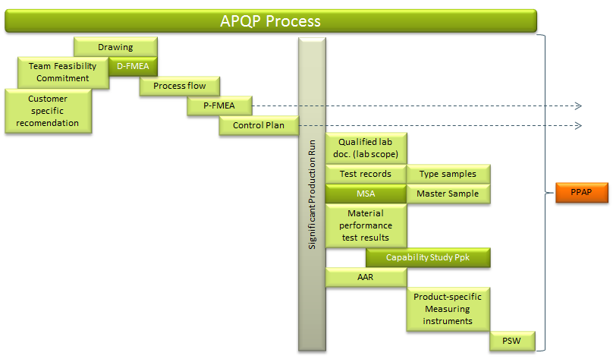
18 points of PPAP
Ytfinhet

Slide 6
APQP
Methodology for Quality Assurance in product development with the aim of creating a consensus between customers and suppliers in the automotive industry. The hope is to simplify the process of product development and simplify the communication between the various parties while respecting the requirements of ISO / TS 16949.
Preventative work - Fail safety
Quality Assurance Plan with a number of activities:
Checklist that follows the entire process
Includes the supplier’s processes
Updated during the project
The result of APQP should be:
A stabil process
One or several Control Plans
An approved initial sample with documentation (PPAP)

Slide 7
Quality Assurance Plan
Step 1:
Understand customer requirements
Customer specific requirements
Critical issues
Product criticism
The team's comments and opinions on the requirements
Suggested improvements
Team Feasibility Commitment
The team's commitment before quotation
Refers to the entire deal
Support from Management

Slide 8
Quality Assurance Plan
Step 2:
Quality assurance of the production process
FMEA
Processflow
Prototype manufacturing
Work instructions
Fixtures
MSA
Testing
Measuring
etc.

Slide 9
Quality Assurance Plan
Step 3:
Verification and project closure
PSW
Full run, Test, Run at Rate (Full run if required by customer)
Project Handover to production

Slide 10
Control Plan
The Control Plan is a method of describing the flow of Quality Assurance. In the Control Plan you describe how to control, test, measure, analyze and document each step in the product workflow
The Control Plan should cover all controls and measurements from material delivery to finished product.
Prototype
Measurements and testing done on prototypes
Pre-Production
All tests and measurements done during pre-production
Production
Tests and measurements done during production
The Control Plan should be consistent with FMEA and the Testing and Control instructions
The Control Plan is a living document

Slide 11
FMEA
FMEA is an method to identify, classify and prioritize risks. A potential risk is judged by severity, occurance and detection. Based on judgement you can calculate a Risk Priority Number (RPN) that can be used to compare risks.

Slide 12
What is ISO/TS16949 ?
Requirements that help assure that the organization’s output meets customer specifications.
Requirements that assure that the quality system is consistently implemented and verifiable.
Requirements for practices that measure the effectiveness of various aspects of the system.
Requirements that support continual improvement of the company’s ability to meet customer needs.
(Making customers happy, and keeping them that way.)
(We must actually do what we say we are supposed to do. )
(In God we trust; all others bring data.)
(We cannot sit still. We must strive to get better all the time, because customers change, and competitors gain strength.)

Slide 13
Benefits of an ISO/TS16949 Quality System
External
Satisfies the demands of current or prospective customers
Improves customer focus
Boost international acceptance and credibility
Places you in an elite category of businesses
Keeps you prepared for external audits and inspections
Facilitates continual improvement
Provides competitive advantage
Internal
from detection mode to prevention mode
Creates consistency throughout the organization
Improves business performance
Less dependency on key individuals
Ensures consistent training.
Improves management oversight.

Slide 14




Produktflöde
Control at arrival
Production Flow
“Poka Yoke”
“End of line”
Delivery
Cutomer control at arrival

Slide 15
Quality Assurance
Step 1
Step 2
Step 3
Understand Customer Requirements
Product
criticism
Team Feasibility Commitment
Quality Assurance Process
Verification and Project Closure

